Slide 1
Weight Uncertainty in Neural Networks
Nova Search Reading Group
by: Simão Gonçalves
date: 2 July 2020

Slide 2
Motivation
Neural Networks lack a confidence metric on their predictions
Critical applications need this: self driving, fraud detection, credit scoring...

Slide 3
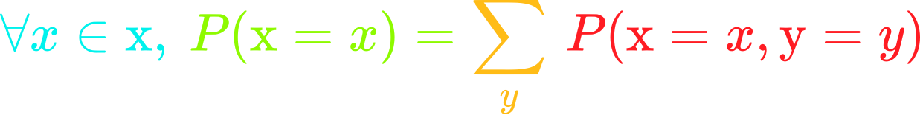
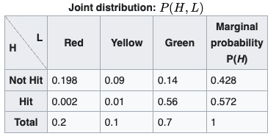
Some background first
Marginal probability:

Slide 4
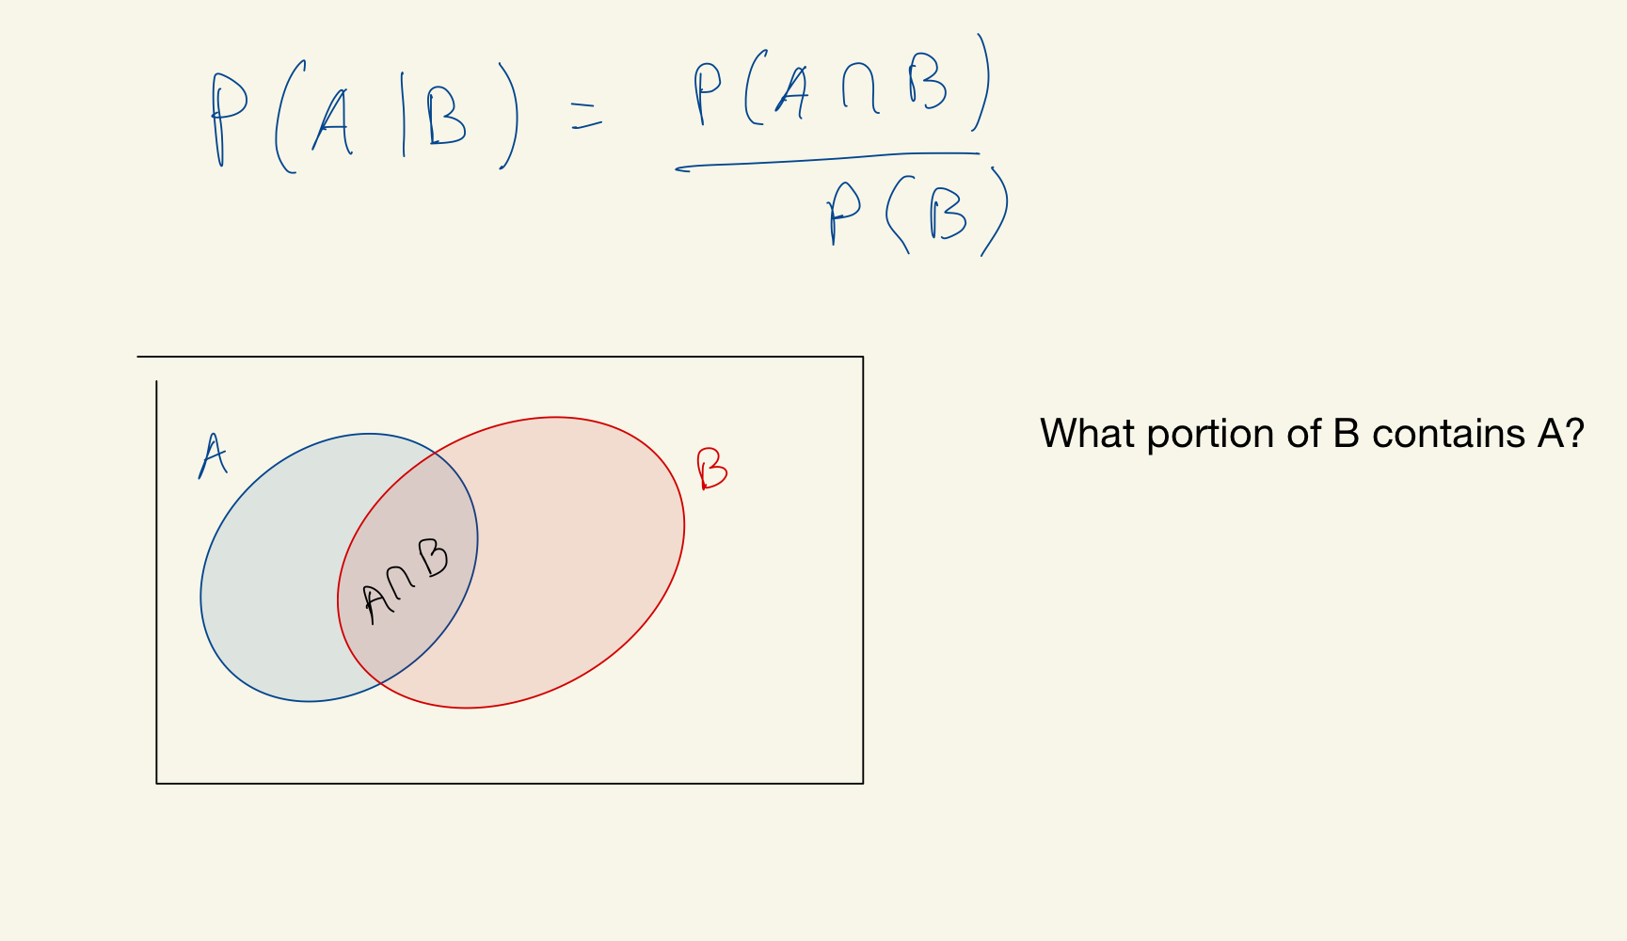
Some background first
Conditional probability:

Slide 5
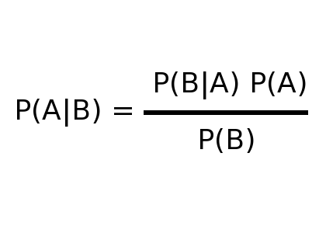
Some background first
Bayes theorem:

Slide 6
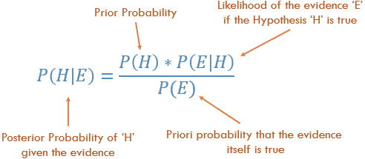
Some background first
Bayes theorem:

Slide 7
Some background first
Bayes theorem:
Example with coin tosses

Slide 8
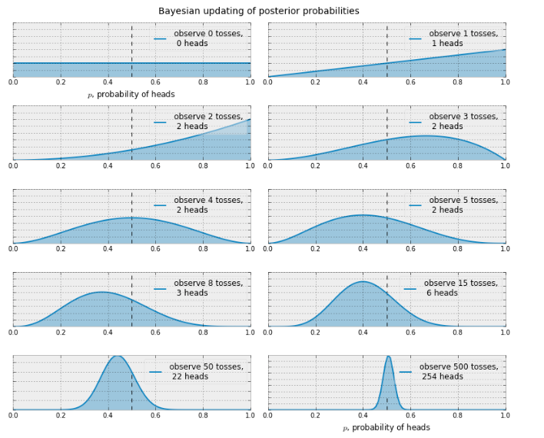
Some background first
Example with coin tosses
Bayes theorem:

Slide 9
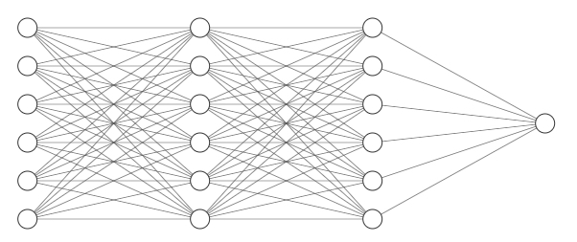
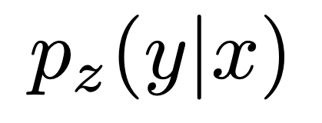
Probabilistic View on Neural Networks
Notes:
the base of probabilistic DL is understanding a neural network as a conditional model on y given x, and it is parameterized by some parameters z (the weights).

Slide 10
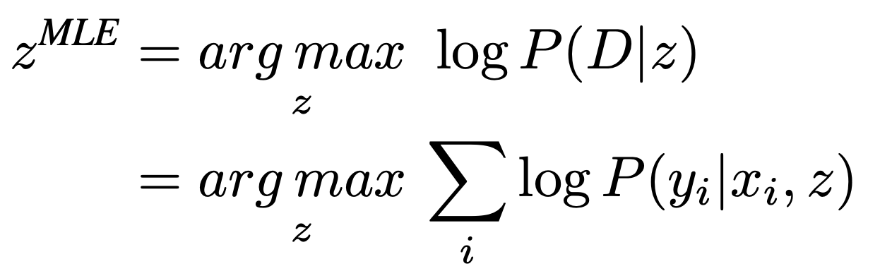
Probabilistic View on Neural Networks
Notes:
We achieve this using optimization techniques

Slide 11
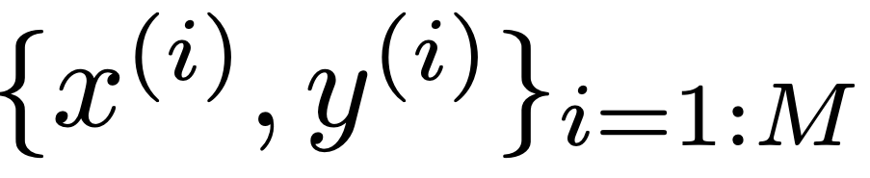
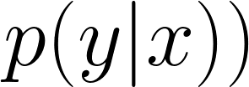
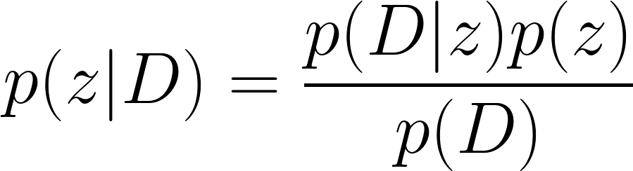
Probabilistic View on Neural Networks
Bayesian setup
Posterior
Notes:
the model learns and updates its weights based on new data. And tries to approxiamte the true distribution p(y|x).
Bayesian inference calculates the posterior distribution of the weights given the data

Slide 12
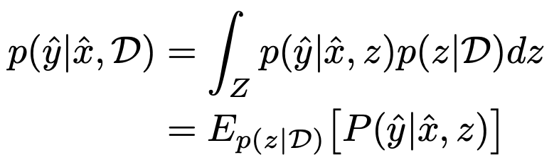
Predictions
Ensemble of predictions
Bad news: it is intractable.

Slide 13
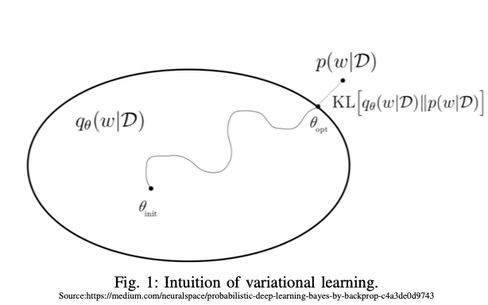
Variational Learning
Notes:
Sample from q instead!

Slide 14
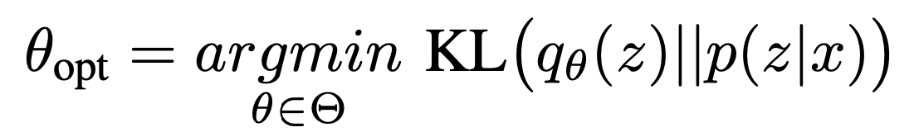
Variational Learning
How do we find q?
Minimize KL divergence between the two distributions.

Slide 15
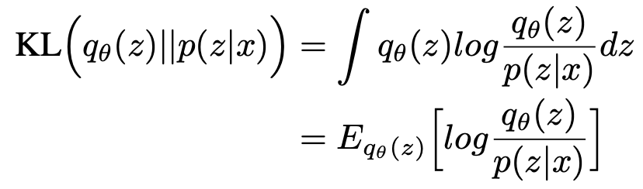
Variational Learning

Slide 16
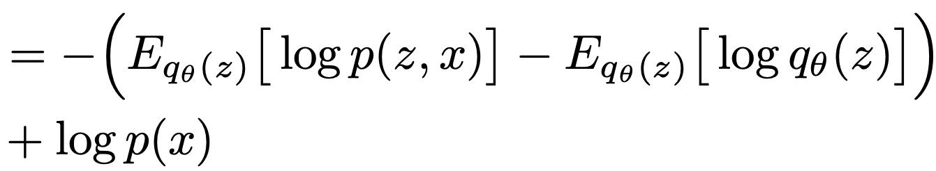
Variational Learning

Slide 17
Variational Learning
Evidence Lower Bound (ELBO):
Notes:
First term is intractable. It simplifies to the second equation.
What values of z give us the optimal variational density?
First term encourages z to explain well the observed data
Second term encourages the variational density to be close to the prior.

Slide 18
Variational Learning
Evidence Lower Bound (ELBO):
Maximizing ELBO minimizes the KL divergence!
Notes:
First term is intractable. It simplifies to the second equation.
What values of z give us the optimal variational density?
First term encourages z to explain well the observed data
Second term encourages the variational density to be close to the prior.

Slide 19
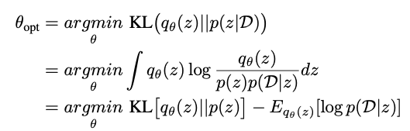
Cost Function
As we saw earlier:
Cost function

Slide 20
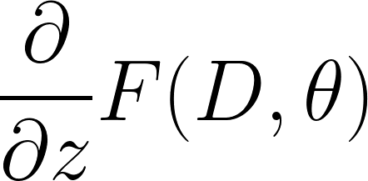
Gradient Learning
We can’t compute gradients of expectations.

Slide 21
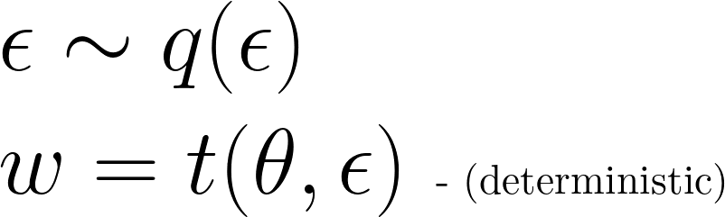
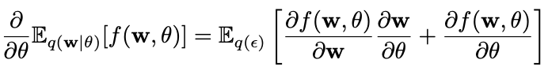
Gradient Learning
Authors’ contribution: Bayes by Backprop
Reparameterize with a deterministic function:
Under certain conditions:

Slide 22
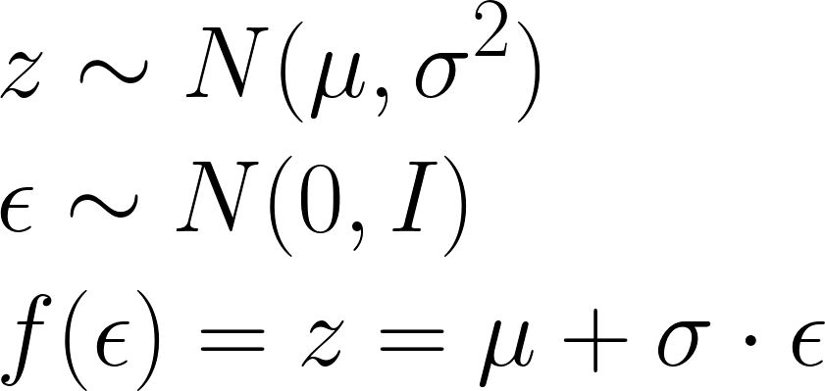

Gradient Learning
Authors’ contribution: Bayes by Backprop
Let’s say our weights follow a normal distribution:

Slide 23

Gradient Learning
Authors’ contribution: Bayes by Backprop
Let’s say our weights follow a normal distribution:

Slide 24

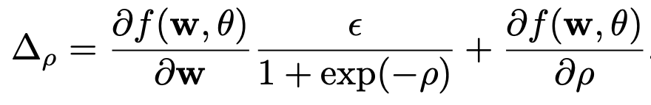
Gradient Learning
Authors’ contribution: Bayes by Backprop
Let’s say our weights follow a normal distribution:

Slide 25
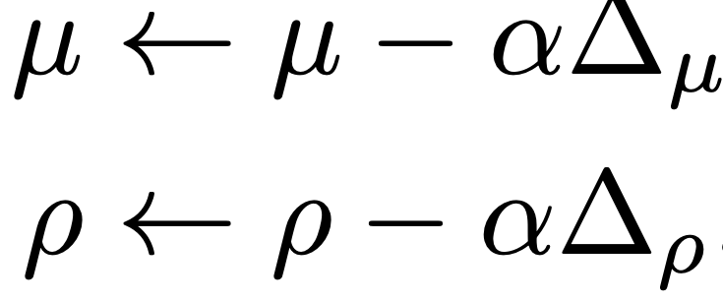
Gradient Learning
Authors’ contribution: Bayes by Backprop
Let’s say our weights follow a normal distribution:

Slide 26
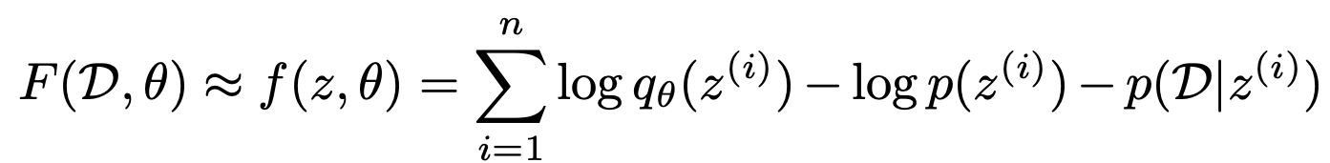
Going back to the cost function
We approximate it by taking samples:

Slide 27
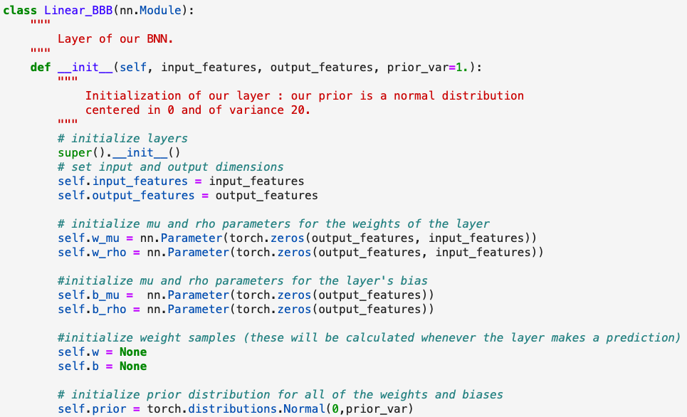
How do we build this?

Slide 28
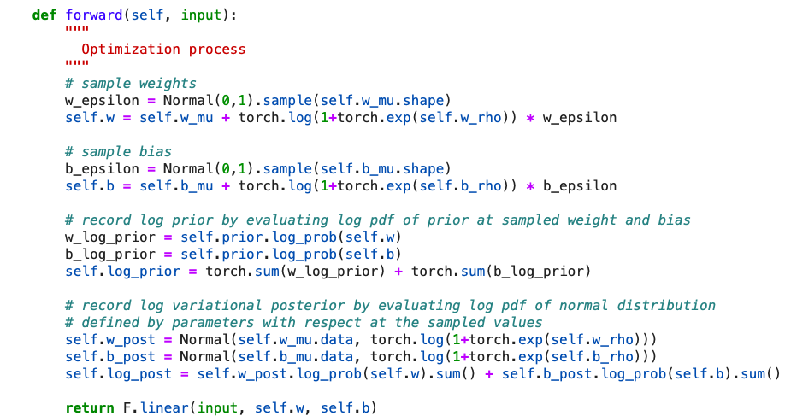
How do we build this?

Slide 29
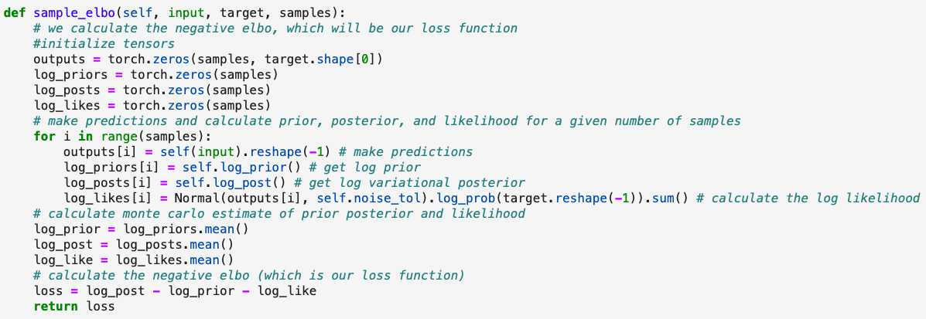
How do we build this?

Slide 30
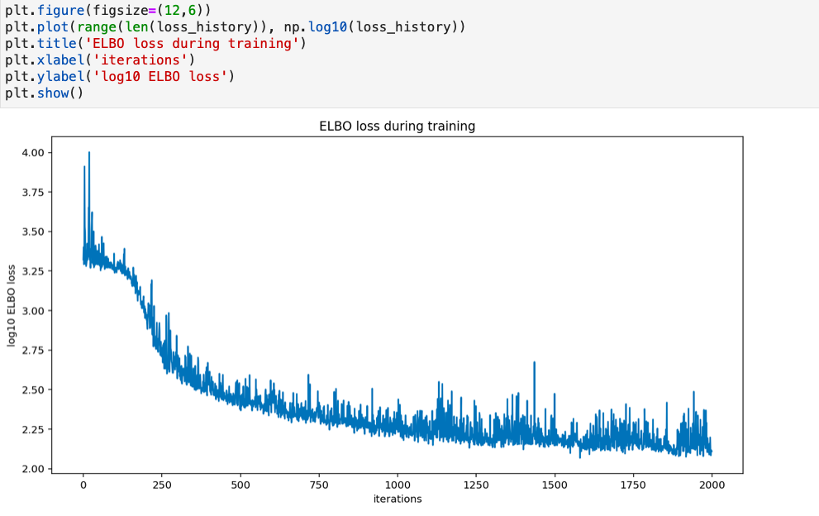
How do we build this?

Slide 31
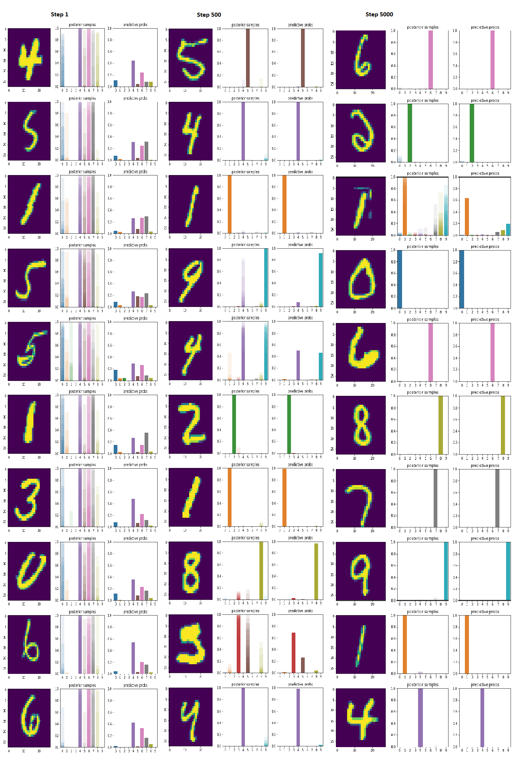
Bayesian deep learning with CNNs - MNIST

Slide 32
Bayesian deep learning with CNNs - MNIST
What happens if we input an image out of distribution of the training set?

Slide 33
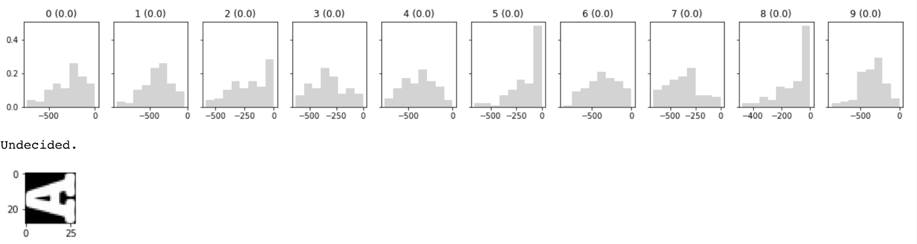
Bayesian deep learning with CNNs - MNIST
What happens if we input an image out of distribution of the training set?

